Slide 1
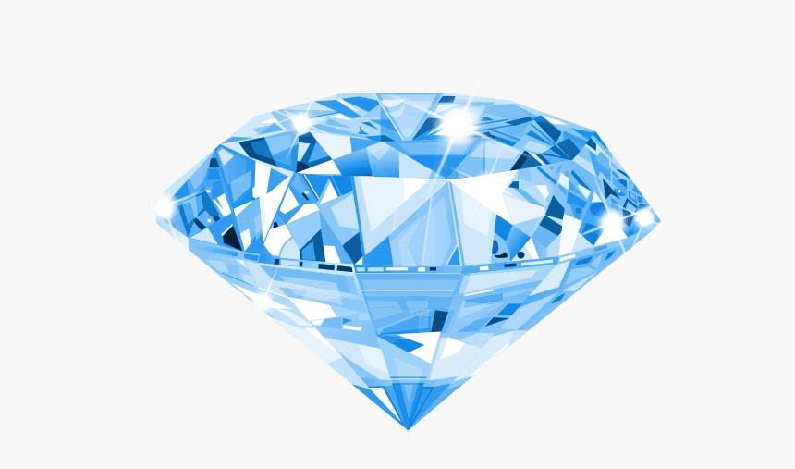
Diamond Price Prediction

Slide 2

Akanksha Ugale
Aspiring Data Scientist
Education:
Post Graduate Diploma in Data Analytics & Machine Learning,
Imarticus Learning
Msc in Computer Science,
Savitribai Phule Pune University
Skills:
Data visualization
Python (NumPy, Pandas, Matplotlib, seaborn).
MySQL
Statistics
Machine learning
Data Structure & algorithms
Work Experience:
Software engineer Trainee (DEC 2020 - JUNE 2021)
Vroomble Services
Worked on python’s flask framework and MySQL database as an intern.
Hands-on Experience in MySQL.
Contact:
ugaleakanksha28@gmail.com
+91 7972372050
linkedIn
GitHub
Projects:
Exploratory Data Analysis (Cardio Good Fitness, IPL Matches)
Key Skills: Data Visualization, Python
Numpy & pandas libraries used to describe data.
Seaborn & matplotlib libraries used to visualize the data.
Breast Cancer Analysis
An implementation of a machine learning algorithm logistic regression to analyze the best fit model.
Logistic regression gave 0.96 Accuracy on test data.
Diamond Price prediction
An implementation of a machine learning model Regression analysis to analyze the best fit model.
XGBoost Regressor gave 0.97 score on test data.

Slide 3
Agenda
Problem Statement
Data Visualization
Feature Selection
Model Building & Predictions
Model Deployment
Comparison of Algorithms
Predict target using original and new inputs
Conclusion

Slide 4
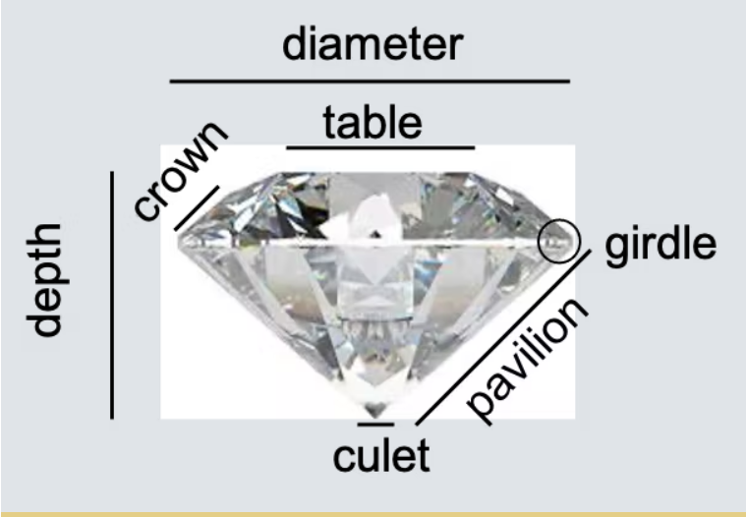
Problem Statement
The Given dataset contains the prices and other attributes of diamond. There are 10 attributes included in the dataset including the target ie. Price Perform Regression Analysis to predict the price of diamond.
Price : price in US Dollars($326-$18,823)
Carat : Weight of Diamond(0.2-5.01)
Cut: Quality of Cut.(Fair,Good,Very Good,Premium,Ideal)
Color: Diamond Color,from J(worst) to D(Best)
Clarity:A measurement of how clean the diamond is.(I1(best),IF(worst)).
X: Length in mm(0-10.74)
Y: Wight in mm(0 - 58.9)
Z: Depth in mm(0-31.80)
Depth: Total Depth Percentage = Z/ mean(x,y) = 2*Z/(X+Y)
Table: Width of top of Diamond relative to widest point(43 – 95)

Slide 5
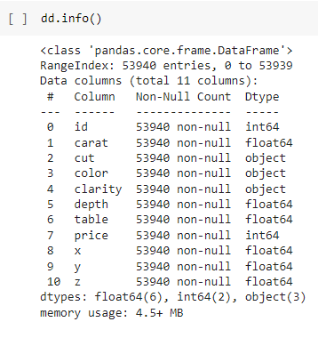
Basic Information:
Shape:(53940,11)
Size:593340

Slide 6
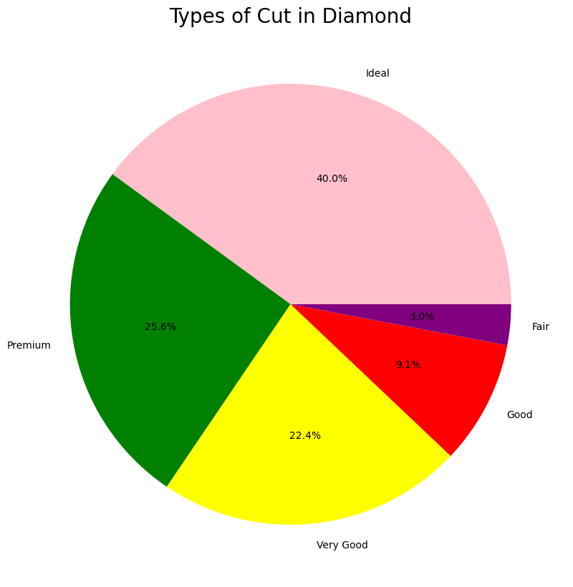
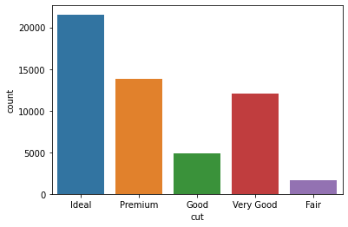
Visualization:-Univariate Analysis
Visualization of categorical Attributes

Slide 7
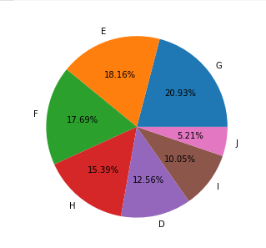
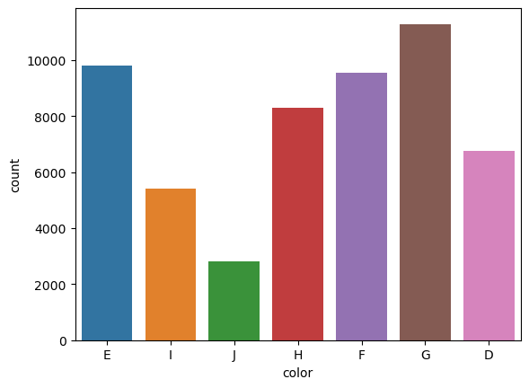

Slide 8
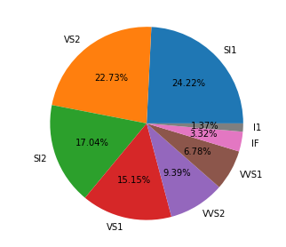
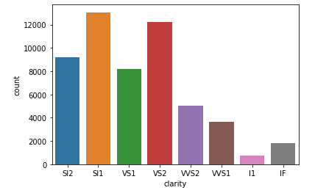

Slide 9
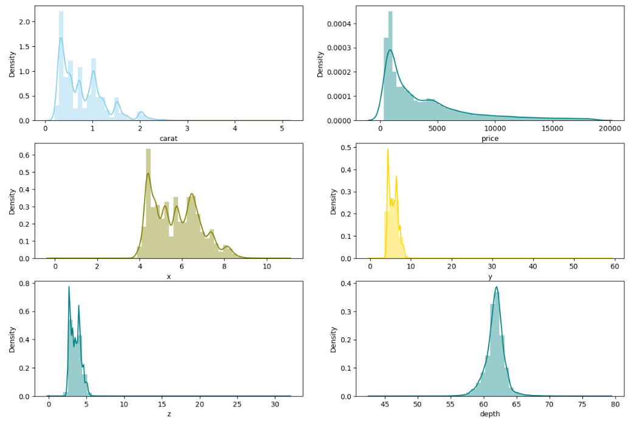

Slide 10
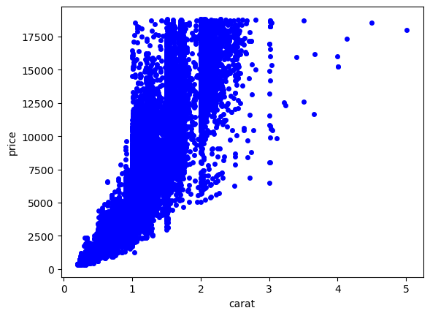
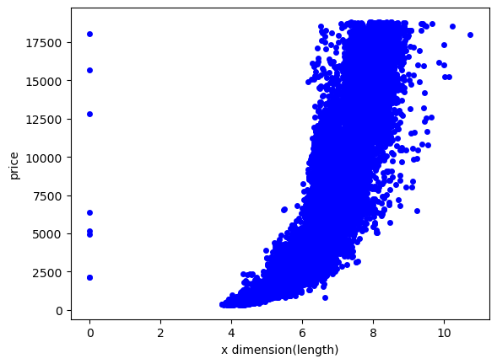
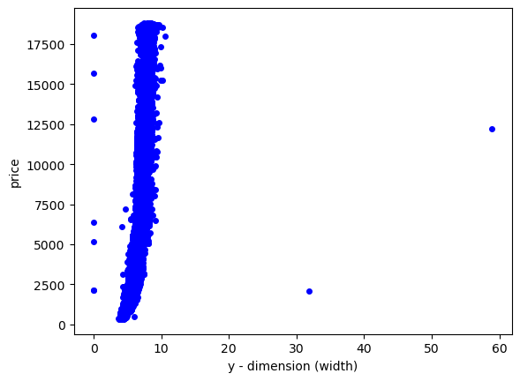
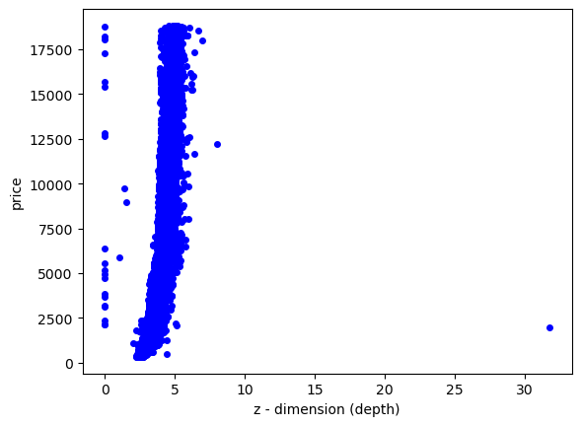
Bivariate Analysis

Slide 11
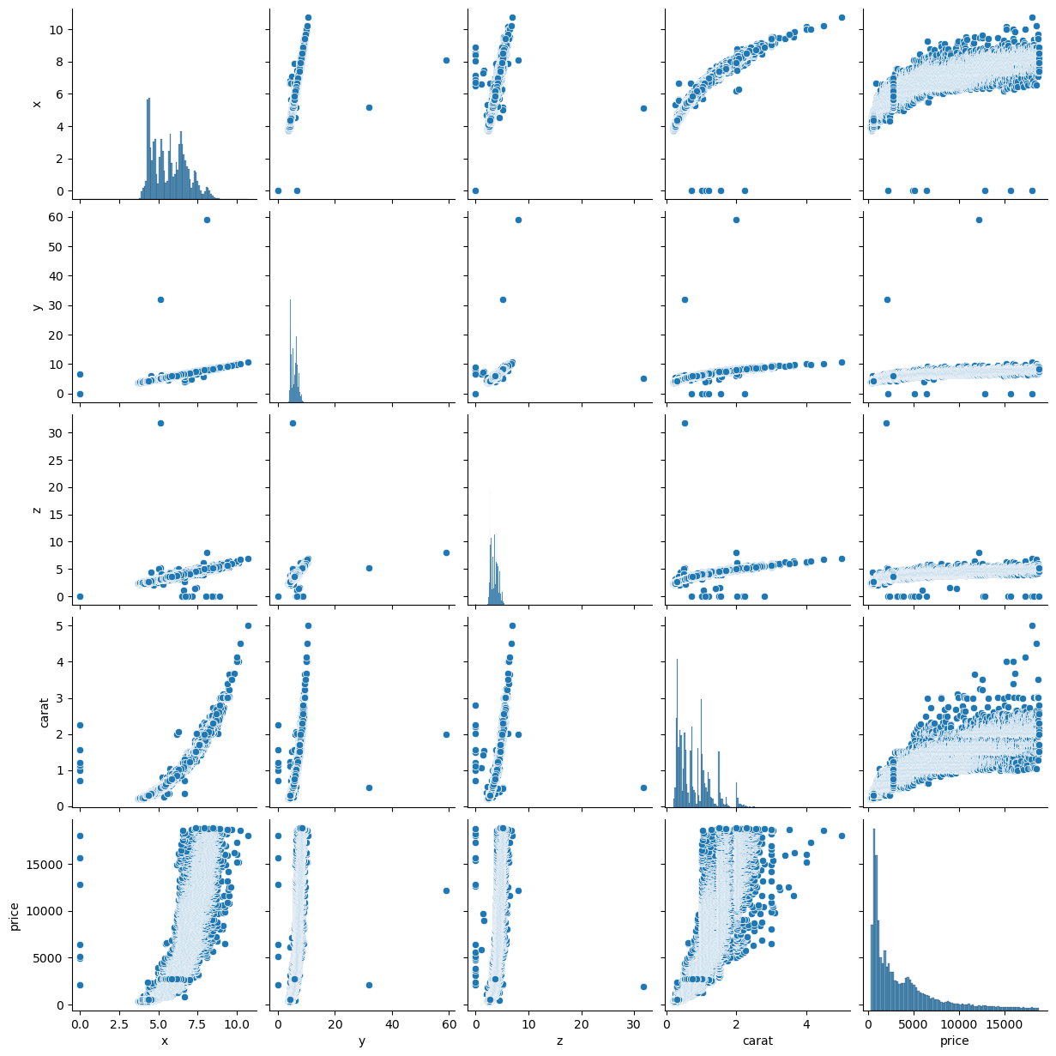

Slide 12
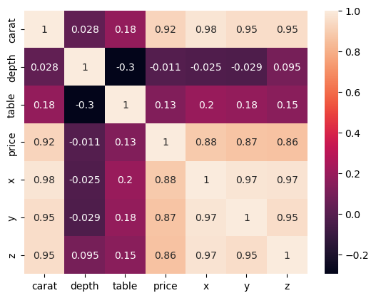
Visualization:-Multivariate Analysis

Slide 13
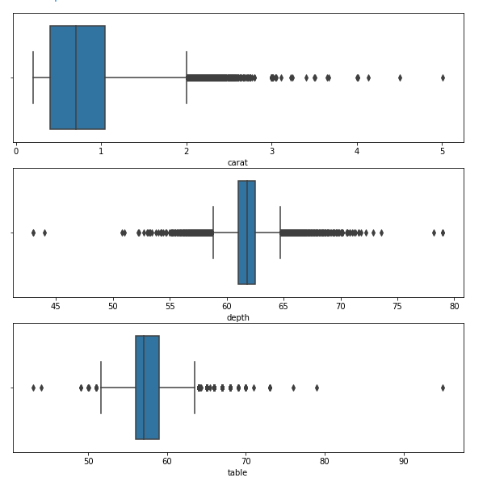
Outlier Handling

Slide 14
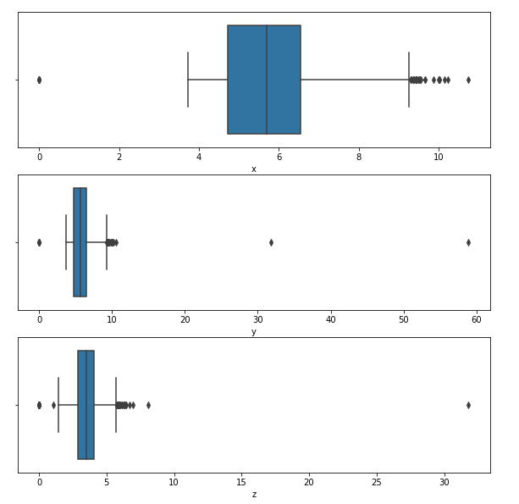

Slide 15
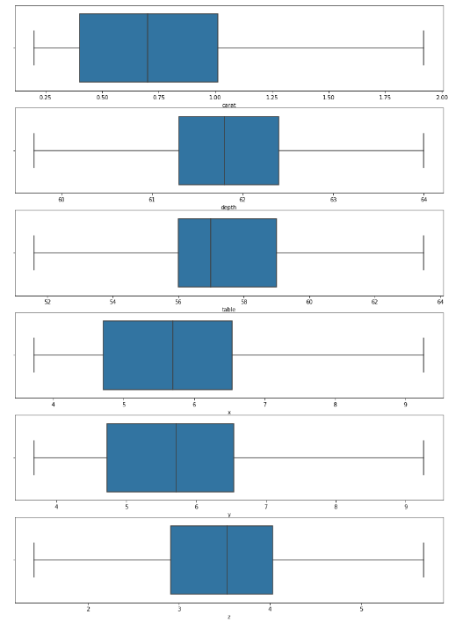
Features After Outlier Handling:

Slide 16
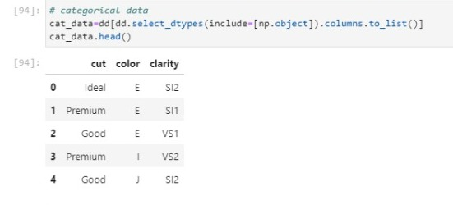
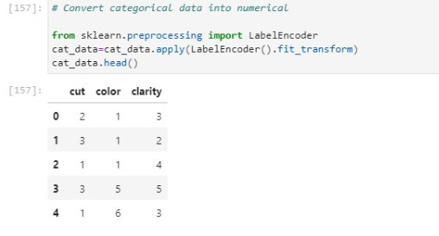
Categorical Data Conversion

Slide 17
Model Building & prediction
We have implemented various machine learning algorithms such as Linear Regression, Decision Tree ,Random Forest, bagging, Boosting and Voting Regressor in order to identify the most optimal model.
For each of these models R2_Score,MSE,RMSE,MAE were calculated.
Further we found importance and results based on the models we have used.

Slide 18
Simple Linear Regression
Independent Variable: Carat
Dependent Variable: Price
Train & Test size/shape
Train R2_score: 0.5254
Test R2_score : 0.5169
Train Size: 43152
Train Shape:(43152,1)
Test Size: 10788
Test Shape:(10788,1)
After Cross Validation
Train R2_score: 0.56
Test R2_score: 0.54

Slide 19
Multiple Linear Regression
Independent Variables: Carat,X,Y,Z,depth,table,cut, color, clarity
Dependent Variable: Price
Train & Test Size & shape
Train Size: 388368
Train Shape:(43152,9)
Test Size: 97092
Test Shape:(10788,9)
Train R2_score: 0.8197
Test R2_score : 0.8190
After Cross Validation
Train R2_score: 0.8150
Test R2_score: 0.8146

Slide 20

Decision Tree Regressor
Decision Tree Regressor algorithm builds a model in the form of tree structure..
In the final prediction is the average of the value of the dependent variable in that particular child node.
Train R2_score: 0.9672
Test R2_score: 0.9619
After Cross Validation
Train R2_score: 0.9617
Test R2_score: 0.9580

Slide 21
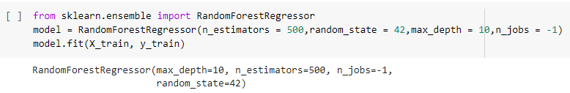
Random Forest Regressor
Random forest is developed version of decision tree regressor.
Random forest works on multiple decision tree model which is trained over the same data & averaging the result of each model ultimately finds more powerful predictive result.
Train R2_score:0.9835
Test R2_score:0.9774
After Cross Validation
Train R2_score: 0.9771
Test R2_score: 0.9721

Slide 22
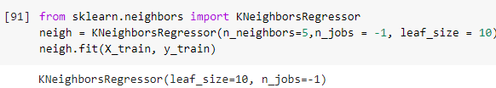
K-Nearest Neighbors Regressor
It is non-parametric method.
Averaging the observation in the same nearest neighbourhood.
Train R2_score: 0.9706
Test R2_score: 0.9505
After Cross Validation
Train R2_score: 0.9511
Test R2_score: 0.9327

Slide 23

Support Vector Regressor
Train R2_score:0.7199
Test R2_score:0.7216
After Cross Validation
Train R2_score: 0.7149
Test R2_score: 0.6762

Slide 24
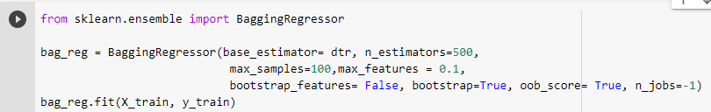
Ensemble Technique
Bagging:
Train R2_score:0.9094
Test R2_score:0.9093

Slide 25
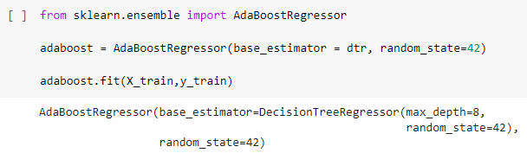
Boosting
Adaptive Boosting
Train R2_score:0.9808
Test R2_score:0.9746
After Cross Validation
Train R2_score: 0.9738
Test R2_score: 0.9714

Slide 26

2. Gradient Boosting
Train R2_score:0.9709
Test R2_score:0.9704
After Cross Validation
Train R2_score: 0.9687
Test R2_score: 0.9682

Slide 27
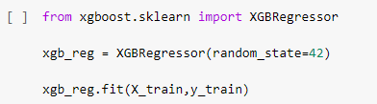
3. Xtreme Gradient Boosting
Train R2_score:0.9711
Test R2_score:0.9709
After Cross Validation
Train R2_score: 0.9686
Test R2_score: 0.9683

Slide 28
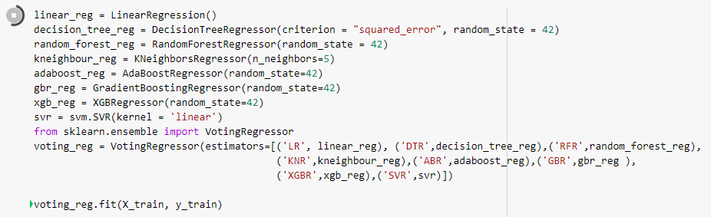
Voting regressor
R2_score: 0.9552

Slide 29
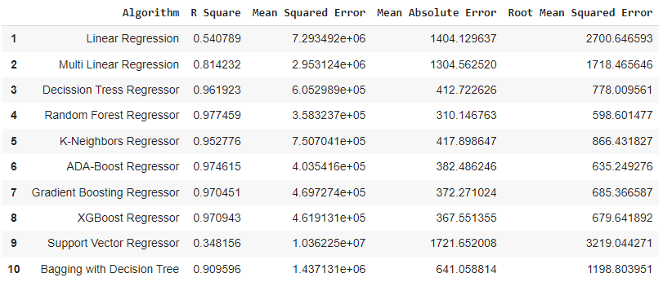
Comparison of Algorithm

Slide 30
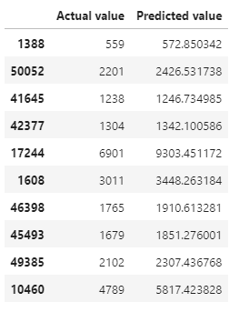
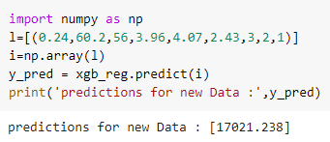
Predict target using original and new inputs

Slide 31
Conclusion
After Feature engineering, we have eliminated id. Because id column won’t help in getting prediction.
After analyzing all the models we can conclude that predictors X,Y,Z & Carat did played a major role for Diamond Price Prediction.
Comparing all the models, XGboost is the best among all the regression models.

Slide 32
Thankyou

